Slide 1
Low Income Housing Tax Credit
IREM LIHTC Seminar & Certification
October 9, 2019

Slide 2
RIHousing Updates
New Executive Director
Department Merger
LEAN Processes
New LIHTC Compliance Manual
Notes:
Mike

Slide 3
Agenda
Introductions
Navigating RIHousing website
LIHTC 101
Compliance Manual
Asset Management
LIHTC and Other Programs
Q & A

Slide 4
QUIZ!

Slide 5
LIHTC 101
The Basics:
Treasury Program
Tax breaks for the owner
Findings of non-compliance = costly $$$
Uncorrected Health and Safety Issues
Over income
Full-time student household
Rent > LIHTC limit
Wrong UA
Notes:
Kathy

Slide 6
LIHTC 101 (cont.)
Most common non-compliance resulting in an 8823:
Household income above income limit at move-in
Owner failed to correctly complete or document tenant’s annual income certification
Violation(s) of the UPCS or local inspection standards
Owner failed to provide annual certifications or provided incomplete or inaccurate certifications
Changes in Eligible Basis or the Applicable Percentage

Slide 7
LIHTC 101 (cont.)
Most common non-compliance resulting in an 8823:
Project failed to meet minimum set aside
Gross rent(s) exceed tax credit limits
Project not available to the general public
Violation(s) of the Available Unit Rule under section 42(g)(2)(D)(ii)
Low-income units occupied by nonqualified full-time students
Owner did not properly calculate utility allowance

Slide 8
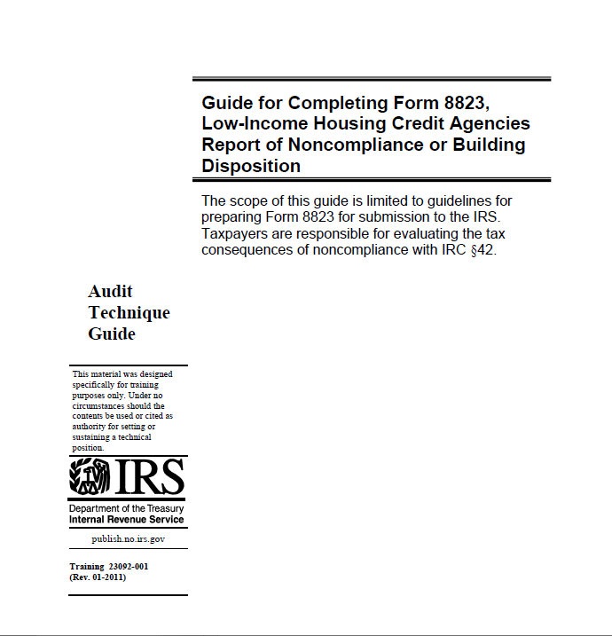
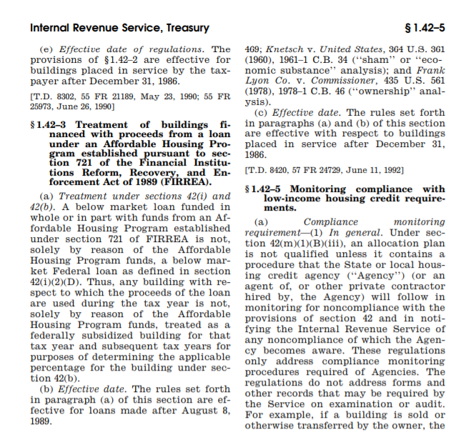
LIHTC 101 (cont.)
8823 Guide:
https://www.irs.gov/pub/irs-utl/lihc-form8823guide.pdf
8823 Guide:
IRS Regulations:
https://www.irs.gov/pub/irs-utl/lihc-form8823guide.pdf
file:///H:/IRC%20Section%2042.Entire/regs%201.42-5.pdf
Notes:
Kathy

Slide 9
LIHTC 101 (cont.)
Years 1 – 10: The Credit Period
First taxable year in which owner claims Housing Credits
Lasts for 10 consecutive taxable years
Years 1 – 15: The Compliance Period
Begins with first year of development’s credit period and lasts for 15 consecutive years
Developments with multiple buildings may have multiple credit periods
Years 16 – 30 or longer: The Extended Use Period
Owner signed a LURA (Declaration of Land Use Restrictive Covenants Agreement)
Committed to maintain the development as low-income housing for at least 30 years beginning with the 1st day of 15-year compliance period
Program Bulletin 07-01 outlines RIHousing’s policy
Notes:
Kathy

Slide 10
LIHTC 101 (cont.)
LIHTC | Section 8
IRS/IRC Section 42 | HUD Regs. 24 CFR Part 5
8823 Guide | HUD Handbook 4350.3
LIHTC Income limits 50%, 60% or IA | 50% of AMI
TIC | 50059
Rent = LIHTC rent limit | Rent = 30% of household adj. income
No full time student households (exemptions) | No assistance for students < 24 & other restrictions
RIHousing, QAP, LURA & Reg. Agreement | HAP Contract
File review | MOR file review HUD form 9834
REAC or UPCS | REAC or MOR observation
WTC | TRACS
3 periods = Credit, Compliance & EUP | Term of the HAP contract
Notes:
Kathy

Slide 11
LIHTC 101 (cont.)
Know your development:
PIS year(s)?
100% LIHTC?
Risk Share Insurance?
Layered with Sec. 8, Vouchers, HOME, NSP, NOP, BHRI, Thresholds, SHP, etc.?
One Project? (all BINs = 1 Project)
Utility benchmarking, Non Smoking?
Have on hand:
8609
LURA
Regulatory Agreement
Other agreements, i.e. AHP, BHRI, etc.

Slide 12
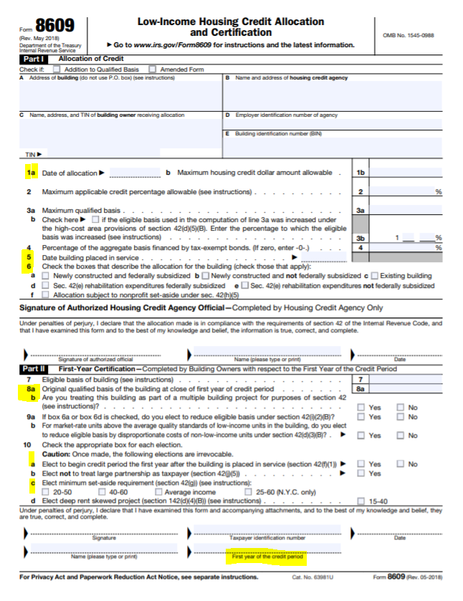
Form 8609

Slide 13
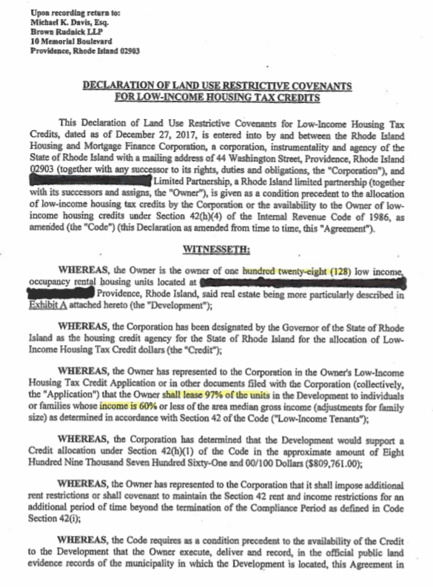
LURA

Slide 14
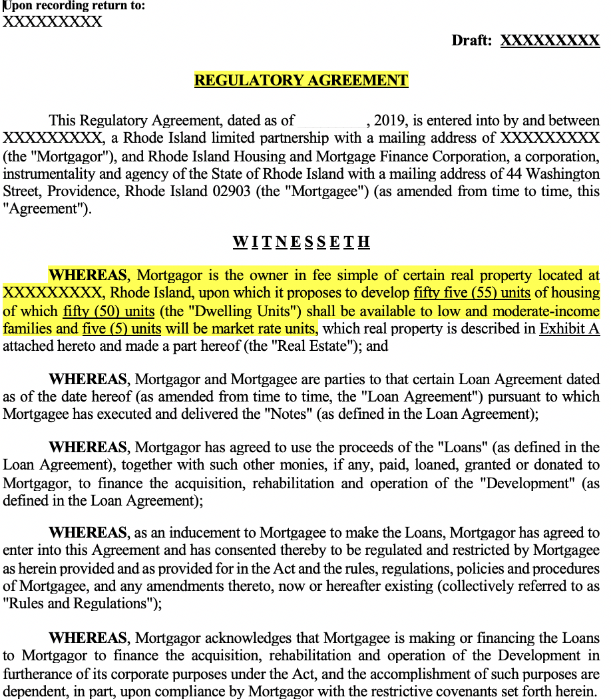
Regulatory Agreement

Slide 15
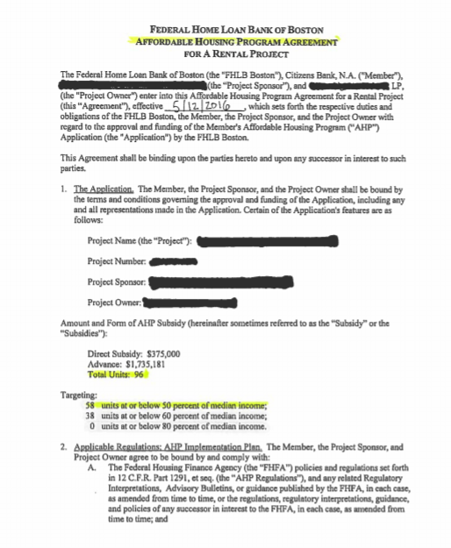
AHP Agreement

Slide 16
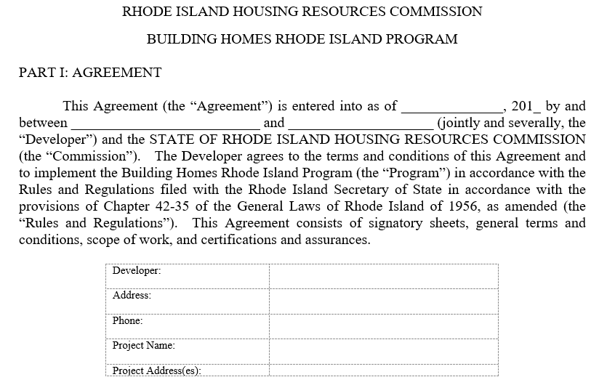
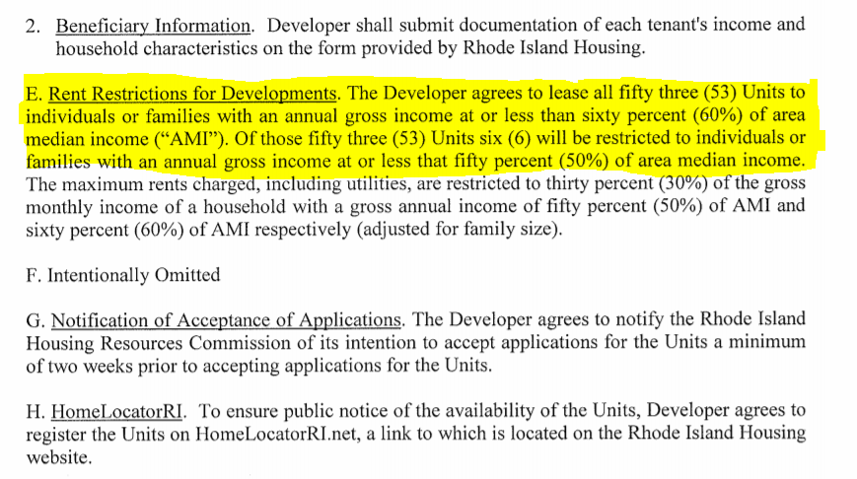
BHRI Agreement

Slide 17
LIHTC 101 (cont.)
Protocol for managing a LIHTC property:
Certified management team
Trained maintenance staff
Consistency, organized files
Current and approved docs and forms
Reliable software
Utility Allowances, rent & income limits
Vacancies and unit turnover
Communication:
Program Bulletins
Notices
eBlasts

Slide 18
LIHTC 101 (cont.) – LIHTC Forms and Documents
Management Forms
RIHousing Forms
Generated by software
Owner required i.e.
Certification questionnaire
Apartment insurance
Smoke detector/alarm agreement
Certification of not looking for employment
Landlord reference
RIH forms can be found at: www.rihousing.com/program-bulletins/

Slide 19
New…RIHousing.com
Notes:
Lenore

Slide 20
LIHTC /Multifamily Compliance
Inspection changes
LIHTC files and units to be reviewed
Regulations approved 2/13/19, Published 2/26/19
Amended the compliance monitoring requirements for LIHTC projects
Effective 1/01/2020
REAC
HUD Notice 19-013
Inspection Notification & Consequences
30 days to implement

Slide 21
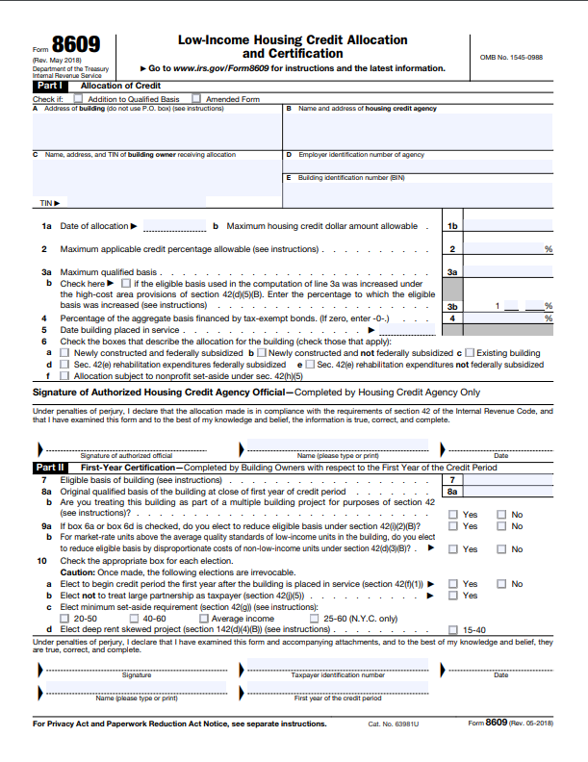
LIHTC Multifamily Compliance (cont.)
Inspection Changes
Sample Size
Required min. sample size based on “the Chart”
Separate Projects ?
8609, Line 8b determines the number of projects at a site
Each building may be treated as a separate project
Likely subject to increased compliance monitoring requirements

Slide 22
LIHTC Multifamily Compliance (cont.)
LIHTC Inspection Changes
Example 1
Owner selected “No” on item 8b
Each building is a project
Large Scattered Site
20 buildings
1 – 5 units in each building
100% of files/units will be inspected
At least once every three years
Example 2
One building = One project
200 units
24 files/units will be inspected
At least once every three years

Slide 23
IRS Guidelines
For LIHTC Projects:
Allow tenant self certification of annual income, including income from assets in 100% LIHTC projects
Assets less than $5000, no 3rd party verification required
REAC inspection performed during the current calendar year suffices as annual physical inspection for LIHTC compliance

Slide 24
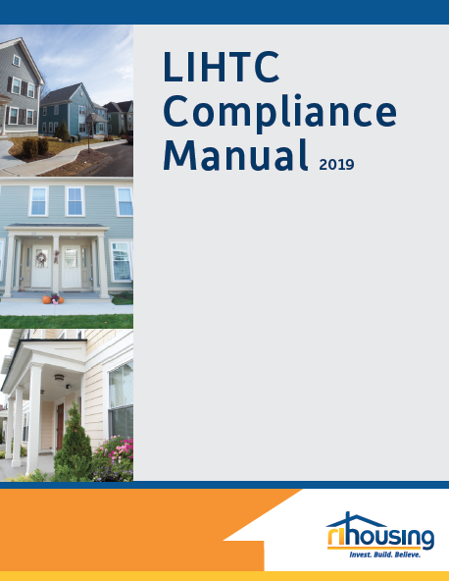
NEW: LIHTC Compliance Manual
Contracted with Costello Compliance, a nationally recognized industry leader and expert in LIHTC compliance
Developed specifically for owners and managers of LIHTC developments in Rhode Island

Slide 25
NEW: LIHTC Compliance Manual (cont.)
Reflects significant changes in policy at RIHousing
Scaled back non-regulatory RIHousing requirements
Consistent with HUD methods
Consistent with IRS guidance and industry best practices
Discusses LIHTC compliance intricacies
Includes the new “Average Income Test”
Case studies and recommendations
Multiple program guide

Slide 26
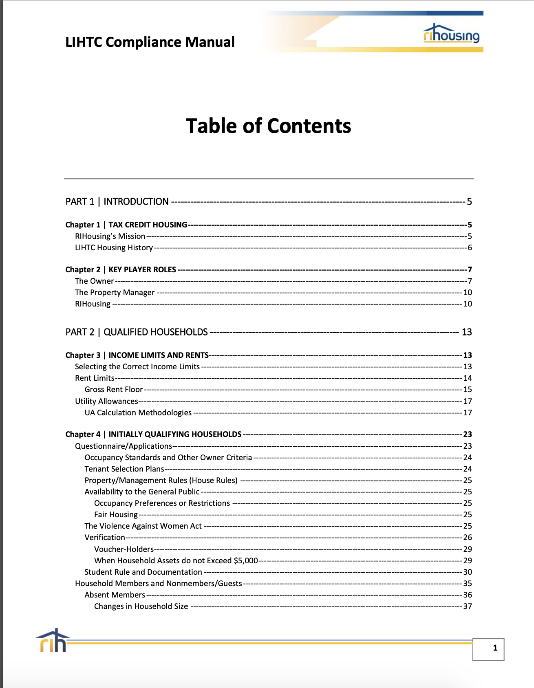
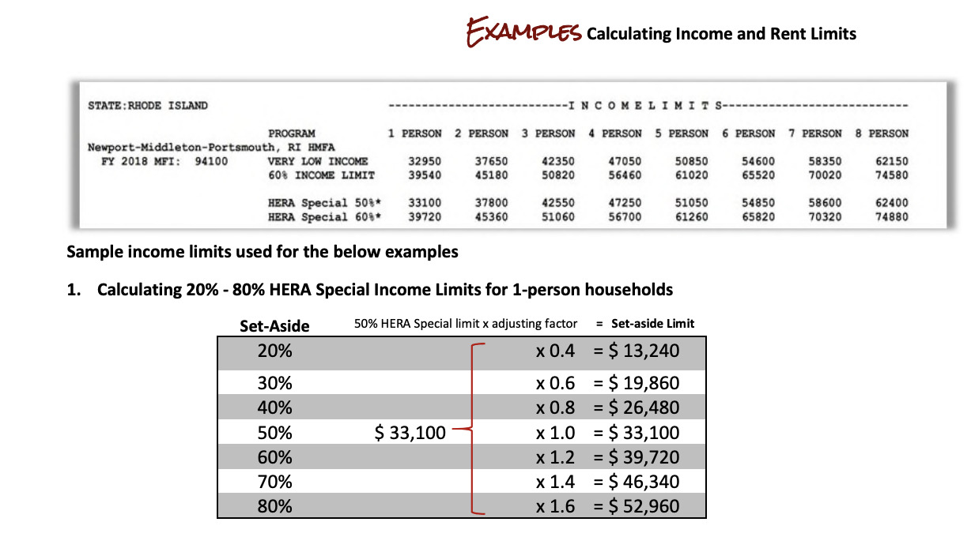
NEW: LIHTC Compliance Manual Features
Easily searchable in pdf format
Clickable Table of Contents
Index
Charts and flow charts
FAQs
www.rihousing.com/compliance

Slide 27
Questions?
Email:
LIHTCManualQuestions@rihousing.com

Slide 28
NEW LIHTC Compliance Manual Demonstration

Slide 29
RIHousing LIHTC Policies
Before | After
AR Waivers Owners needed to request Seldom approved Applicable with year 3 of tenancy | Abbreviated Certifications allowed only for 100% LIHTC projects Owner must request and receive approval for Abbreviated Annual Certification (AAC) Owners of 100% LIHTC projects upon approval are allowed to conduct an Abbreviated AR Certification for all years after IC/MI
Annual income calculations Must use highest amount Averaging hours not allowed If tenant works 35 - 40 hrs., calculate 40 hrs. | Allow Section 8 method of averaging Tenant works 34-40 hrs./week, HUD calculates this as average of 37 hrs.
Range of paystubs to calculate annual income RIHousing policy: 4 - 6 , strongly recommended 6 paystubs | Suggest 2 months of pay history to align with HOME Require 2-month minimum when using paystubs to verify employment income
Rent increase $25 every 6 months w/o approval More than $25, requires approval | Rent increase more than 5% needs pre-approval

Slide 30
RIHousing LIHTC Policies (cont.)
Before |  | After
HUD form 9887 allowed LIHTC Lease addendum must be used with all lease forms Lease Agreement: 1-year term minimum |  | 9887 not allowed unless HUD funding LIHTC Lease addendum not allowed with HUD lease forms * HUD Approved 10/2/19 Lease Agreement: 6-month term minimum

Slide 31
LIHTC Quiz Answers
1. RIHousing issues a QAP on an annual basis. True or False?
2. In an acquisition rehab project, the Placed-in-Service date is found on the 8823 form. True or False?
3. Owner/agent must be familiar with the extended use agreement (LURA) because it establishes the necessary occupancy and affordability requirements. True or False?
4. LIHTC regulations specify that owner/agent should not count the assets of minor children. True or False?
5. The value of an asset that has been disposed for less than fair market value should be counted for two years. True or False?

Slide 32
LIHTC Quiz Answers
Katie receives Social Security Disability Insurance and has a Rep Payee. Katie claims she has no assets. No further action is required on the part of the property manager. True or False?
It is verified that Pauly D. receives gross employment income of $342.50/week, and only works 32 weeks per year. According to LIHTC rules, the managing agent will annualize his income and compute the wages based on 52 weeks. True or False?
Ralph gives his mom $225 monthly to pay her utility bills, his mom lives alone in a LIHTC unit. According to LIHTC regulations, the amount Ralph gives his mom is excluded from her annual income because it is for her basic utilities. True or False?

Slide 33
An applicant’s employer indicates that the applicant will work 36-40 hours a week in the coming year. What number of hours should be used in calculating annual income? Answer: 36 38 40
It is acceptable to calculate income using different methods for different applicants to ensure that all households are income qualified at move-in. True or False?

Slide 34
LIHTC Policy Clarifications
LIHTC Lease Addendum APPROVED by HUD 10.2.19
Current tenant certification not located in tenant file. If project is in compliance period, this is an 8823 finding.
If a full annual certification is not completed because owner/agent has an old/existing annual recertification
(AR) waiver (from RIH or IRS) this will be a finding of
non-compliance.

Slide 35
LIHTC Policy Clarifications (cont.)
All applicants/tenants required to complete alimony affidavit and child support affidavit at IC, MI and AR, exception if AAC in place
Asset accounts with zero balance should be listed on TIC unless there is an AAC in place.
Race and ethnicity data is required for data collection
purposes. These fields must be populated in WTC
and should also be on the TIC.

Slide 36
LIHTC Policy Clarifications (cont.)
ALL Initial or Move-in Certifications
Requires full certification with 3rd party verification of income, assets > $5,000 and student status
100% LIHTC annuals
Once AAC has been approved, households can self certify annual income (including all assets), student status must be verified
Not 100% LIHTC annuals
Requires full certification with 3rd party verification of income, assets > $5,000 and student status

Slide 37
LIHTC Tenant File Requirements
For all IC/MI files
Tenant income certification(TIC)
LIHTC program student status affidavit
Recurring gifts affidavit
Certification of zero income (if applicable)
Child support self affidavit
Alimony affidavit
Worksheet for income & expenses or calculation tapes
Verification of income
Certification of assets less than $5,000 or
Verification of assets
Clarification notes (as applicable)
Rental application (time & date stamped when received)
Lease agreement & RIHousing’s LIHTC lease addendum
Unit inspection documentation
Release of information consent
EPA’s hazard information pamphlet and disclosure form- if building built prior
to 1978 (acknowledgment of receipt of the pamphlet is acceptable).
Race and ethnicity self-certification

Slide 38
LIHTC Tenant File Requirements (cont.)
For all 100% LIHTC annuals with AAC approval:
Tenant income certification (TIC)
LIHTC program student status affidavit
Verification of student status 3rd party from the educational institution (when applicable)
Self-affidavit of annual income (including income from assets)
Clarification notes (as applicable)
Lease agreement & RIHousing’s LIHTC lease addendum
Unit inspection documentation
Release of information consent

Slide 39
LIHTC Tenant File Requirements (cont.)
For non 100% LIHTC annuals and those without AAC
Tenant income certification (TIC)
LIHTC program student status affidavit
Recurring gifts affidavit
Certification of zero income (if applicable)
Child support self affidavit
Alimony affidavit
Worksheet for income & expenses or calculation tapes
Verification of income
Certification of assets less than $5,000 or verification of assets
Clarification notes (as applicable)
Lease agreement & RIHousing’s LIHTC lease addendum
Unit inspection documentation
Release of information consent

Slide 40
LIHTC On-going Compliance Monitoring
Throughout Compliance and Extended Use periods:
Unit and file review based on the minimum unit sample size chart effective 1/01/2020
REAC or UPCS or Mortgagee
At least once every three years
Annual owner’s reports
Compliance Fees - PB 2018-04
Comply with WTC requirements
Report Incidents
Asset management and financial matters

Slide 41
Asset Management Overview
Financial Monitoring:
Audited Financial Statements
Analysis, Compliance with Agreements/Covenants
HUD Reporting – Risk Share
Surplus Cash Distribution approvals
AHP Passthrough Covenants Monitoring
Risk Management
Quarterly Interim Operating Statements – compared to prior year to identify trends
Annual Budget Collection
Approval of Operating Reserve Withdrawals
Notes:
Susan

Slide 42
Asset Management Overview (cont.)
Annual Escrow Analysis
Approval of ‘NOP’ Operating Subsidy Requisitions
Delinquency Reporting
Internal Loan Workout Meetings
Owner/Manager Meetings to discuss Action Plans/ Resources/Resolutions
Review and Approval of Pro-forma Operating Budget for all new RIHousing financed projects
Rent Analyses
Vacancy Rates, CPU and Operating trends

Slide 43
Asset Management Offerings
Supportive Resources available:
Historical Average Operating Expense data
REAC – failing scores on Risk Share insured. HUD regulations and protocol to follow
Meetings to discuss challenges/plans or future financing through RIHousing underwriting team
NOP training

Slide 44
Asset Management Topics of Focus
Current Topics:
Rent Levels
NOP
Updating WTC
RISE Audits
2019 Escrow Analysis
Budgets@RIHousing.com

Slide 45
Questions?

Slide 46
Asset Management Contacts:
Manager of Asset Management
Susan Halloran
shalloran@rihousing.com 401-450-1339
Financial Analyst
Kate Mashburn
kmashburn@rihousing.com 401-450-1351
Asset Management Compliance Specialist
Renelder Duncan
rduncan@rihousing.com 401-433-1602

Slide 47
LIHTC Layered with HOME
The HOME Program
Eligible HOME activities = rental and homeownership
Unit receiving HOME funds = HOME assisted
HOME requirements:
Income and rent restrictions
Property standards ( UPCS & Local Code)
Affordability Period up to 20 years or longer
Capital funds, not operating
Non-compliance = repayment of HOME funds
Notes:
Lenore

Slide 48
LIHTC Layered with HOME (cont.)
Most common non-compliance:
Not having 2 months of source documentation
Not using Section 8 student rule
Tenant based voucher subsidies
Remember:
HOME lease addendum – not stand alone, only executed when new lease is signed.
Source Documents – required at move-in and every 6th year of the HOME affordability period
Source documents - at least 2 months of history
must be covered by documentation

Slide 49
LIHTC Layered with HOME (cont.)
https://files.hudexchange.info/resources/documents/ComplianceinHOMERentalProjects_GuideforPropertyOwners.pdf

Slide 50
LIHTC layered with HOME (cont.)
Coming Soon
HOME Program Training

Slide 51
Contact Information
Michael DiChiaro
Assistant Director, Asset Management/Compliance
mdichiaro@rihousing.com, 401-457-1274
Kathleen Millerick
Rental Compliance/Training Coordinator
kmillerick@rihousing.com, 401-457-1241
Lenore Coughlin
Multifamily Compliance Supervisor
lcoughlin@rihousing.com, 401- 457-1258

Slide 52
Contact Information
LIHTC Program Multifamily Compliance Specialists:
Glen Turner gturner@rihousing.com, 401-457-1154
Jamie Wolcott jwolcott@rihousing.com, 401-450-1343
Kristi Richardson krichardson@rihousing.com, 401-450-1307
HOME Program Compliance Specialist:
Brittany Toomey btoomey@rihousing.com, 401-429-1455
Compliance Specialist/ MF Programs:
Melissa DeLuca mdeluca@rihousing.com, 401-429-1496

