Slide 1
Low Income Housing Tax Credit
IREM Virtual LIHTC Presentation & Certification
November 13, 2020

Slide 2
Agenda
Introductions
Agency Updates
LIHTC Program Reminders
LIHTC Compliance during COVID-19
Challenges
Temporary new rules
Updates on procedures and new forms
What’s new
LIHTC Compliance reporting via WTC
LIHTC Compliance Manual updates
Notes:
Kathy

Slide 3
Agency Updates
Michael DiChiaro
Agency updates
Acknowledgements

Slide 4
LIHTC Program Reminders
Years 1 – 10: The Credit Period
First taxable year in which owner claims Housing Credits
Lasts for 10 consecutive taxable years
Years 1 – 15: The Compliance Period
Begins with first year of development’s credit period and lasts for 15 consecutive years
Developments with multiple buildings may have multiple credit periods
Years 16 – 30 or longer: The Extended Use Period
Owner signed a LURA (Declaration of Land Use Restrictive Covenants Agreement)
Committed to maintain the development as low-income housing for at least 30 years beginning with the 1st day of 15-year compliance period
Program Bulletin 07-01 outlines RIHousing’s policy
Notes:
Kathy

Slide 5
Tax Credit Program Reminders (cont.)
Know your development:
PIS year(s)?
100% LIHTC?
Risk Share Insurance?
Layered with Sec. 8, Vouchers, 811, HOME, HTF NSP, NOP, BHRI, Thresholds, SHP, CMF, etc.?
One Project? (all BINs = 1 Project)
Utility benchmarking, Non Smoking?
Have on hand:
8609
LURA
Regulatory Agreement
Other agreements, i.e. AHP, BHRI, etc.
Notes:
Kathy

Slide 6
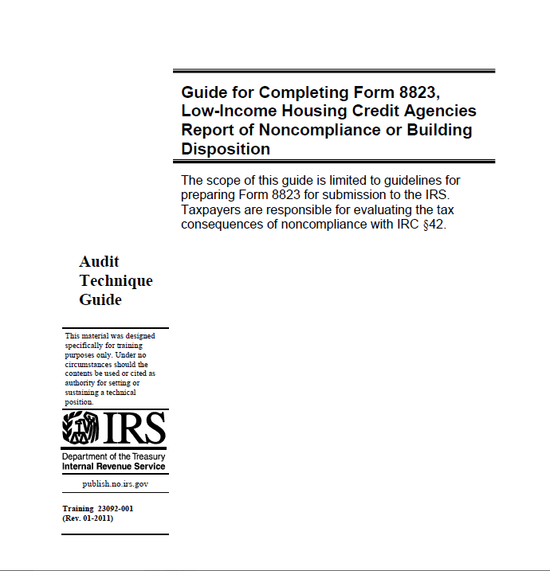
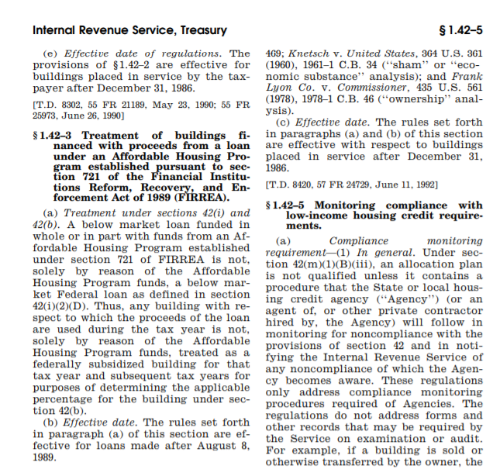
LIHTC Resources Reminder
8823 Guide:
https://www.irs.gov/pub/irs-utl/lihc-form8823guide.pdf
8823 Guide:
IRS Regulations:
https://www.irs.gov/pub/irs-utl/lihc-form8823guide.pdf
file:///H:/IRC%20Section%2042.Entire/regs%201.42-5.pdf
Notes:
Kathy

Slide 7
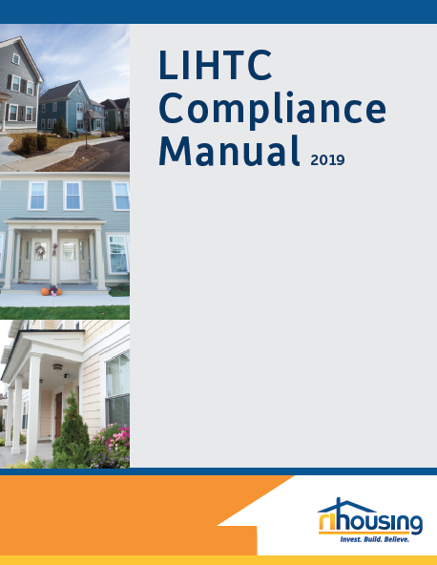
LIHTC Resources Reminder (cont.)
Contracted with Costello Compliance, a nationally recognized industry leader and expert in LIHTC compliance
Developed specifically for owners and managers of LIHTC developments in Rhode Island
Notes:
Kathy

Slide 8
Have Questions?
Email:
LIHTCManualQuestions@rihousing.com
Notes:
Kathy

Slide 9
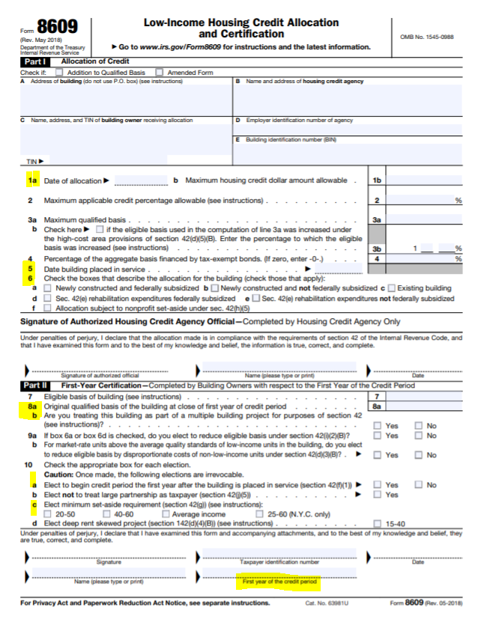
Form 8609
Notes:
Kathy

Slide 10
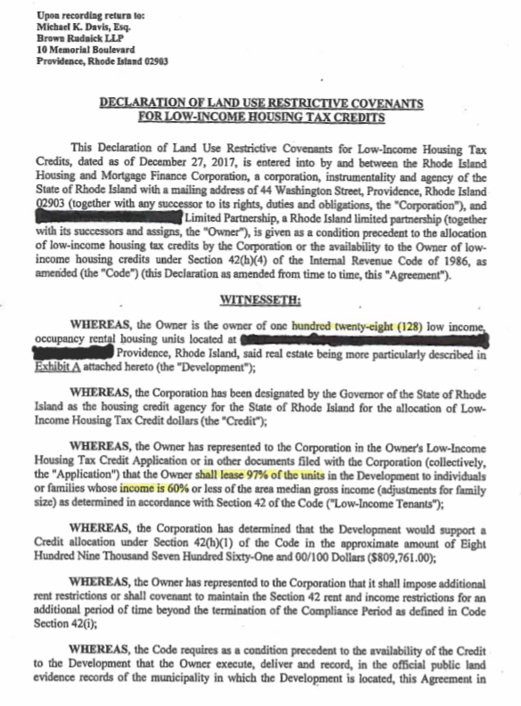
LURA
Notes:
Kathy

Slide 11
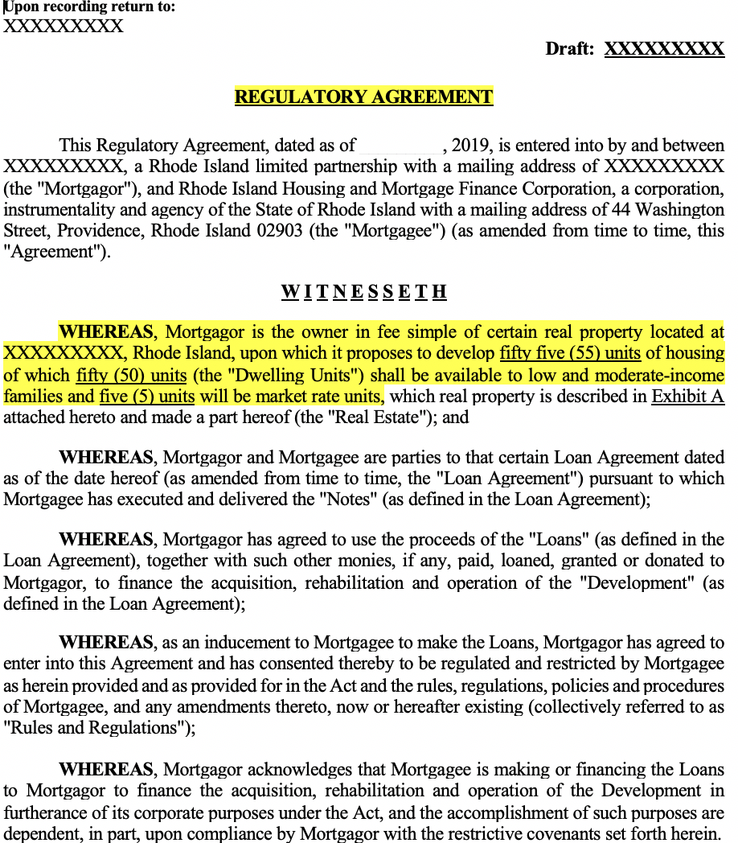
Regulatory Agreement
Notes:
Kathy

Slide 12
Questions?

Slide 13
LIHTC Compliance During COVID-19
Short-Term Extensions to Certain Housing Credit and Housing Bond Deadlines Due to COVID-19
Notice 2020-23
Published April 10, 2020
Taxpayers have until July 15, 2020 to perform specified time-sensitive actions due to be performed on or after April 1, 2020 and before July 15, 2020
The Secretary of the Treasury has also determined that any person performing a time-sensitive action listed in either § 301.7508A-1(c)(1)(iv) – (vi) of the Procedure and Administration Regulations or Revenue Procedure 2018-58, 2018-50 IRB 990 (December 10, 2018), which is due to be performed on or after April 1, 2020, and before July 15, 2020 (Specified Time-Sensitive Action), is an Affected Taxpayer.
For an Affected Taxpayer with respect to Specified Filing and Payment Obligations, the due date for filing Specified Forms and making Specified Payments is automatically postponed to July 15, 2020.
Notice 2020-53
Published July 1, 2020
Waiver period extended through December 31, 2020
Notes:
Lenore

Slide 14
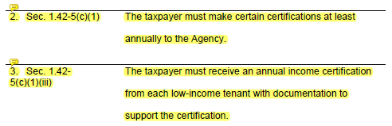
LIHTC Compliance During COVID-19 (cont.)
Revenue Procedure 2018-58
Identifies provisions from Notice 2020-23 (page 126)
Owner’s certification deadline extended through July 15, 2020
Annual certifications due between April 1, 2020 and July 2020 must be completed by December 31, 2020
Notes:
Lenore

Slide 15
LIHTC Compliance During COVID-19 (cont.)
Challenges
No requirement to monitor
Furloughed staff
Customer service
Safety of staff and tenants
Solutions
Monitoring is not prohibited
Bring the team back
Maintain relationships
Waive physical inspections
Notes:
Lenore

Slide 16
LIHTC Compliance During COVID-19 (cont.)
Temporary New Rules
LIHTC monitoring is not required, but RIHousing continues to perform file reviews and desk reviews.
Electronic file reviews
Reduced sample size
Upload to SharePoint
Responses may also be submitted on this platform
Desk Reviews
Performed annually
Asset Managers request information from site to ensure LIHTC compliance
Notes:
Lenore

Slide 17
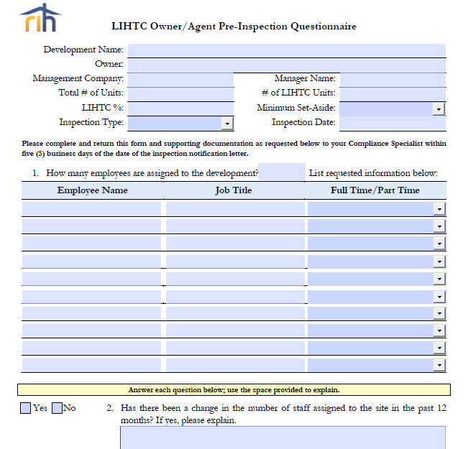
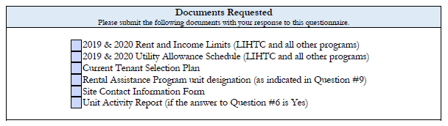
LIHTC Updates and New Forms
LIHTC Owner/Agent Questionnaire
Part of the Desk Review regardless of whether an inspection or file review is scheduled
Return to your Asset Manager with requested documents
Notes:
Lenore

Slide 18
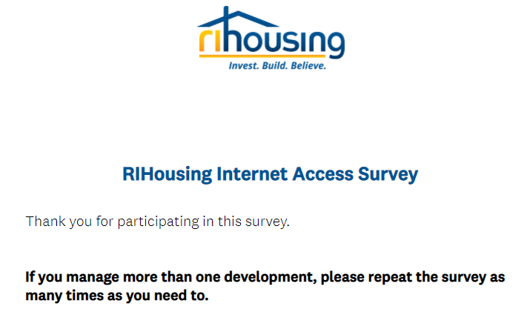
LIHTC Updates and New Forms (cont.)
Internet Access Survey
Notes:
Lenore

Slide 19
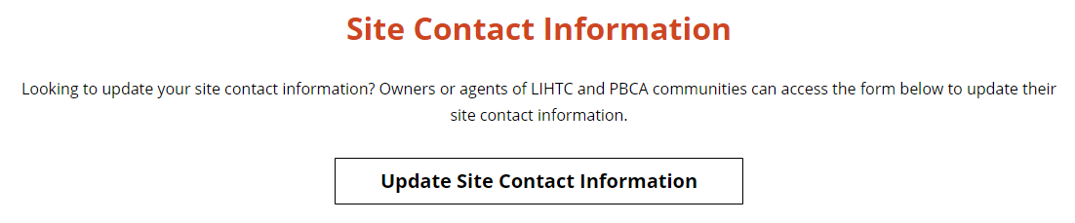
Site Contact Information
1st Generation
2nd Generation
3rd Generation
Now

Slide 20
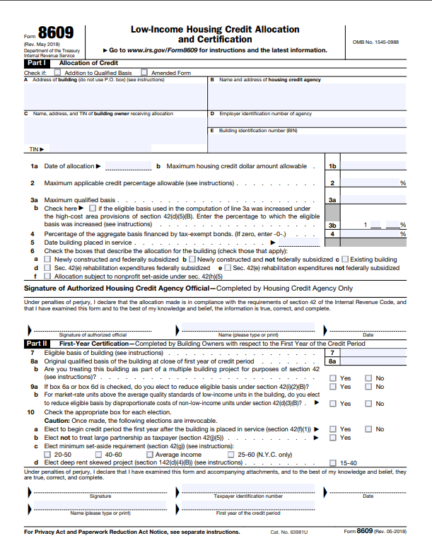

LIHTC Updates and New Forms (cont.)
Inspection Changes
Sample Size
Proposed Rule published on July 7, 2020
Required min. sample size based on the lesser of 20% or “the Chart”
Separate Projects
8609, Line 8b determines the number of projects at a site
Each building may be treated as a separate project
Likely subject to increased compliance monitoring requirements
Notes:
Lenore

Slide 21
Questions?

Slide 22

Let’s Meet Back Here in 10 Minutes

Slide 23
LIHTC Quiz
Question #1
Receiving an 8823 is a good thing.
True or False
Notes:
Hope and Lenore

Slide 24
LIHTC Quiz
Question #1
Receiving an 8823 is a good thing.
True or False
Notes:
Hope and Lenore

Slide 25
LIHTC Quiz
Question #2
I can find the Placed-In-Service date in the
LURA
Form 8823
Form 8609
Regulatory Agreement
Notes:
Hope and Lenore

Slide 26
LIHTC Quiz
Question #2
I can find the Placed-In-Service date in the
LURA
Form 8823
Form 8609
Regulatory Agreement
Notes:
Hope and Lenore

Slide 27
LIHTC Quiz
Question #3
A LIHTC development is layered with HTF, NOP, and 811. The owner/agent must ensure compliance with which program(s)?
811
HTF
LIHTC
All of the Above
Notes:
Hope and Lenore

Slide 28
LIHTC Quiz
Question #3
A LIHTC development is layered with HTF, NOP, and 811. The owner/agent must ensure compliance with which program(s)?
811
HTF
LIHTC
All of the Above
Notes:
Hope and Lenore

Slide 29
LIHTC Quiz
Question #4
A LIHTC development is layered with HOME. Which income and rent limits should be listed on the TIC?
LIHTC
HOME
LIHTC and HOME
None
Notes:
Hope and Lenore

Slide 30
LIHTC Quiz
Question #5
The Average Income Test is a new method of calculating annual household income.
True or False
Notes:
Hope and Lenore

Slide 31
LIHTC Quiz
Question #5
The Average Income Test is a new method of calculating annual household income.
True or False
Notes:
Hope and Lenore

Slide 32
Customer Service Changes
To better serve residents and property managers, RIHousing has expanded its communication platform to provide easier access to resources that may be helpful in resolving tenant concerns. Now have a dedicated voice and email box monitored by experienced RIHousing asset management staff:
Phone (401) 433-1616
E-mail tenantconcerns@rihousing.com
New ‘chatbot’ on our contract administration webpage: provides answers to most common questions received by owners, managers, residents, and applicants. Also redirects you to staff person at RIHousing best able to assist.
Notes:
Hope

Slide 33

Chatbot
Notes:
Hope

Slide 34
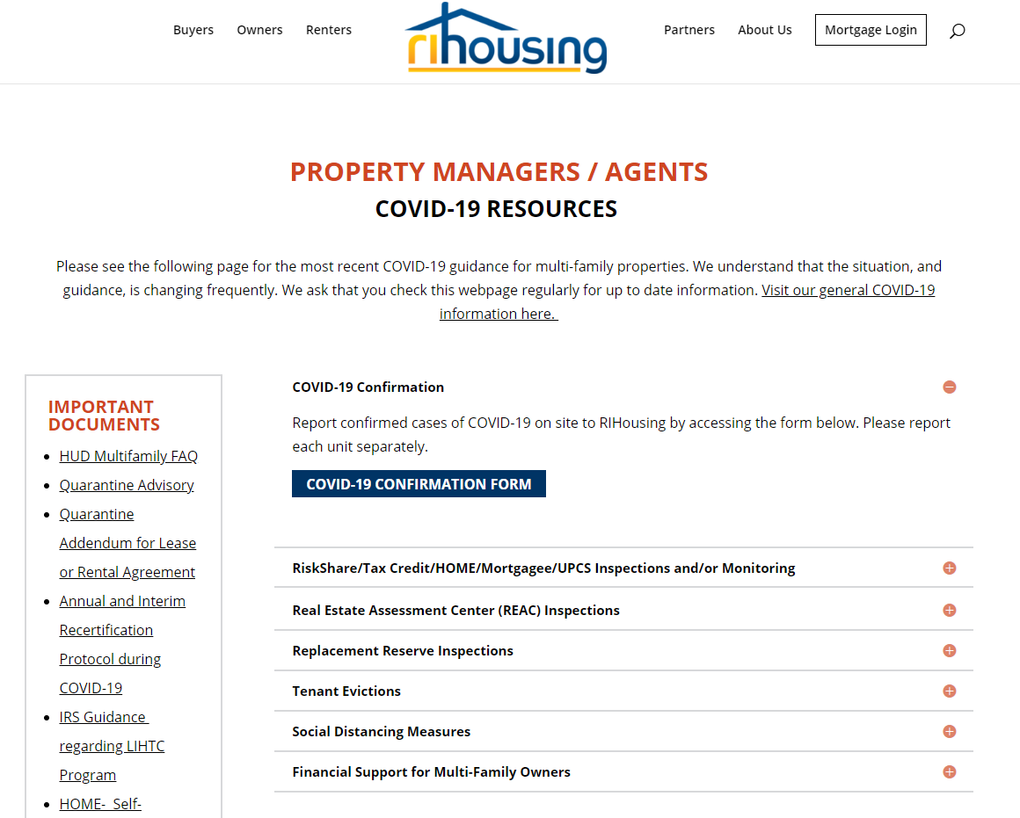
Covid-19 Resources
Notes:
Hope

Slide 35
New MOR Process
Interview
Done remotely, likely over the phone
Document upload
Done remotely via SharePoint, link is available today if you want it!
File Review
Also done via SharePoint, the file list is provided 48 hours ahead of time
Physical inspection
The only part that needs to be done on site, brief as possible. Everyone must remain masked.
Response
Can also be uploaded via SharePoint
Notes:
Hope

Slide 36
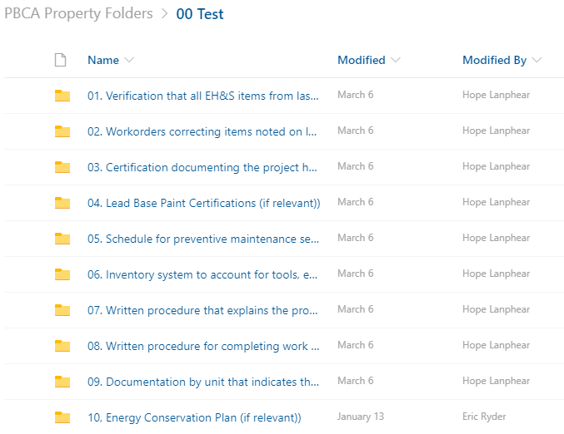
SharePoint
Notes:
Hope

Slide 37
Updates
New FMRs
Released for 2021 and are up on HUD’s webpage
New OCAF factor
Coming soon, until HUD releases it OCAFs effective after 2/15/2021 are on hold
New utility factor
Coming soon, until HUD releases it OCAFs effective after 2/15/2021 are on hold
Notes:
Hope

Slide 38
Questions?

Slide 39
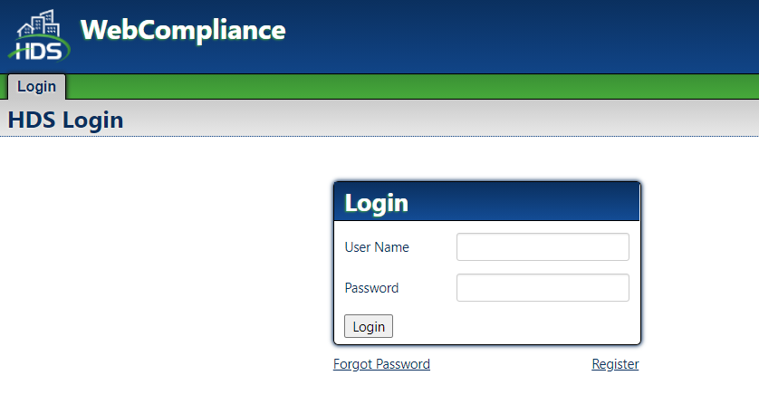
WTC Demonstration
https://webcompliance.rihousing.com/webcompliance/Login/Login
Notes:
Kathy

Slide 40
LIHTC Manual Updates
Revisions to LIHTC Manual
Updated policies
Updated template forms
Updated FAQs
Notes:
kathy

Slide 41
Questions?

Slide 42
Contact Information
Michael DiChiaro
Assistant Director, Asset Management/Compliance
mdichiaro@rihousing.com, 401-457-1274
Kathleen Millerick
Rental Compliance/Training Coordinator
kmillerick@rihousing.com, 401-457-1241
Hope Lanphear
Multi Family Housing Compliance Manager
hlanphear@rihousing.com, 401-429-1409
Lenore Coughlin
Multi Family Housing Compliance Manager
lcoughlin@rihousing.com, 401-457-1258

Slide 43
Contact Information (cont.)
Senior Asset Managers:
Glen Turner gturner@rihousing.com, 401-457-1154
Jamie Wolcott jwolcott@rihousing.com, 401-450-1343
HOME Program Senior Asset Manager:
Brittany Toomey btoomey@rihousing.com, 401-429-1455

Slide 44
Contact Information (cont.)
Asset Managers:
Adriana De La Cruz, adelacruz@rihousing.com, 401-457-1238
Jesus Diaz, jdiaz@rihousing.com, 401-457-1233
Kristi Richardson, krichardson@rihousing.com, 401-450-1307
Latoshia Denson, ldenson@rihousing.com, 401-450-1329
Lillian Morel, lmorel@rihousing.com, 401-429-1472
Marilyn DaPonte, mdaponte@rihousing.com, 401-457-1261
Richelle Fitzgerald, rfitzgerald@rihousing.com, 401-457-1227

Slide 45
Asset Management Financial Contacts:
Manager of Asset Management
Susan Halloran
shalloran@rihousing.com 401-450-1339
Financial Analyst
Kate Mashburn
kmashburn@rihousing.com 401-450-1351
Asset Management Compliance Specialist
Christine Mattio
cmattio@rihousing.com 401-433-1602

